Slide 1
Tema: The regional development trap in the EU
Autor: Andrés Rodríguez-Pose

Slide 2
1.
The problem

Slide 3
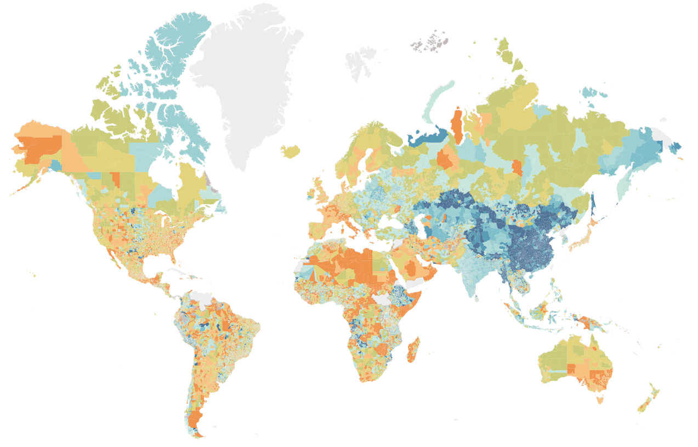
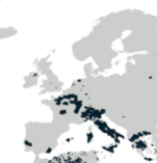
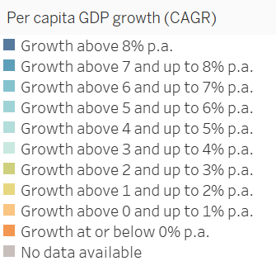
The problem
McKinsey Global Institute, 2023

Slide 4
2.
What is a development trap?

Slide 5
Starting point: the Middle-Income Trap (MIT)
An economy that suffers from a sharp drop in economic dynamism after a successful transition from low-income to middle-income status (Gill & Kharas, 2007)
Identified thus far at country level
In past century, only a handful of countries went from low- to high-income
For example: South Korea and Brazil had identical per capita income in 1950. Today, South Korea is high-income country. Brazil is middle income country since the 1960s, stagnating at about 23% of US per capita income
Many economies, by contrast, have gone from low- to middle-income

Slide 6
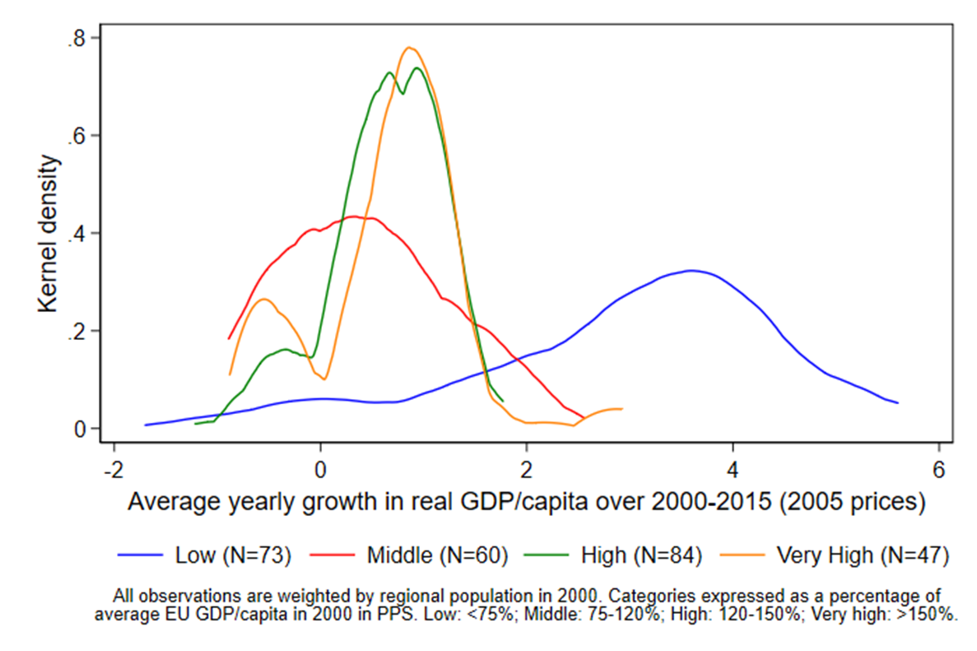
What have we done?
Apply the development trap conceptual framework to European regions: to identify the regions in (or at risk of falling into) a development trap
Using the uneven growth performance of EU regions: could be a sign that some are falling into traps

Slide 7
3.
Measuring the trap

Slide 8
Identifying a development trap
Three dimensions of economic dynamism
GDP per capita
The region itself in the past
Productivity
The country it belongs to
Employment
The EU

Slide 9
Translated into formulae
$$DT_{1, i, t}=\left\{\begin{aligned}1−\frac{\sum_{y}{D_{i,t}^{y,R}}+\sum_{y}{D_{i,t}^{y,MS}}+\sum_{y}{D_{i,t}^{y,EU}}}{9}, if NUTS2 in MS≥2 \\ 1−\frac{\sum_{y}{D_{i,t}^{y,R}}+\sum_{y}{D_{i,t}^{y,EU}}}{6}, if NUTS2 in MS=1\end{aligned}\right.$$
$$DT_{2,i,t}=\left\{\begin{aligned}−1×\frac{[(\sum_{y}{a_{i,t}^{y,R}}+\sum_{y}{a_{i,t}^{y,MS}}+\sum_{y}{a_{i,t}^{y,EU})×9^{−1}]−μ_{1990}^{Raw DT2}}}{σ_{1990}^{DT2}}, if NUTS2 in MS≥2 \\ −1×\frac{[(\sum_{y}{a_{i,t}^{y,R}}+\sum_{y}{a_{i,t}^{y,EU})×6^{−1}}]−μ_{1990}^{Raw DT2}}{σ_{1990}^{DT2}}, if NUTS2 in MS=1\end{aligned}\right.$$

Slide 10
4.
Development trap in the EU

Slide 11
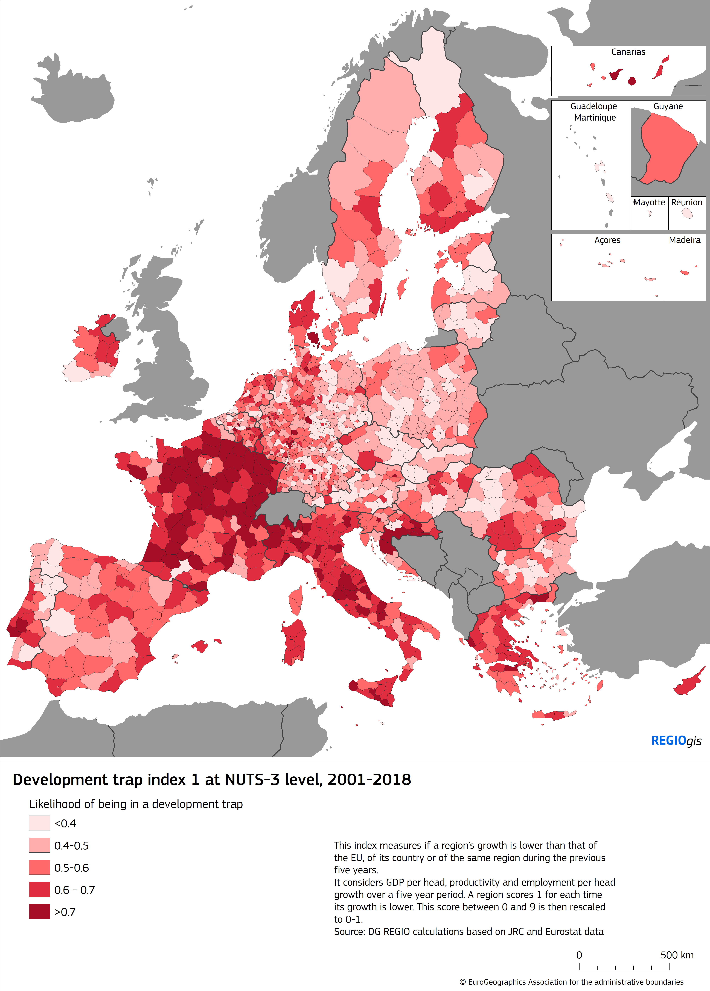
Risk

Slide 12
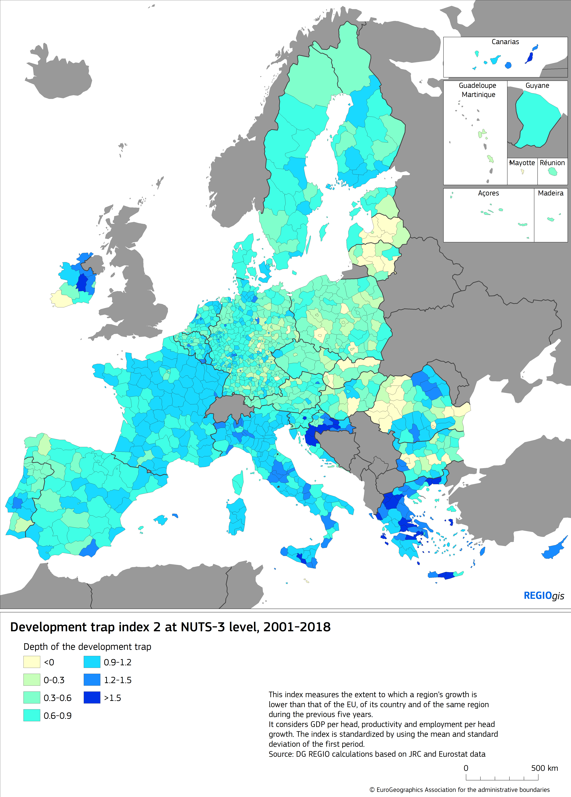
Intensity

Slide 13
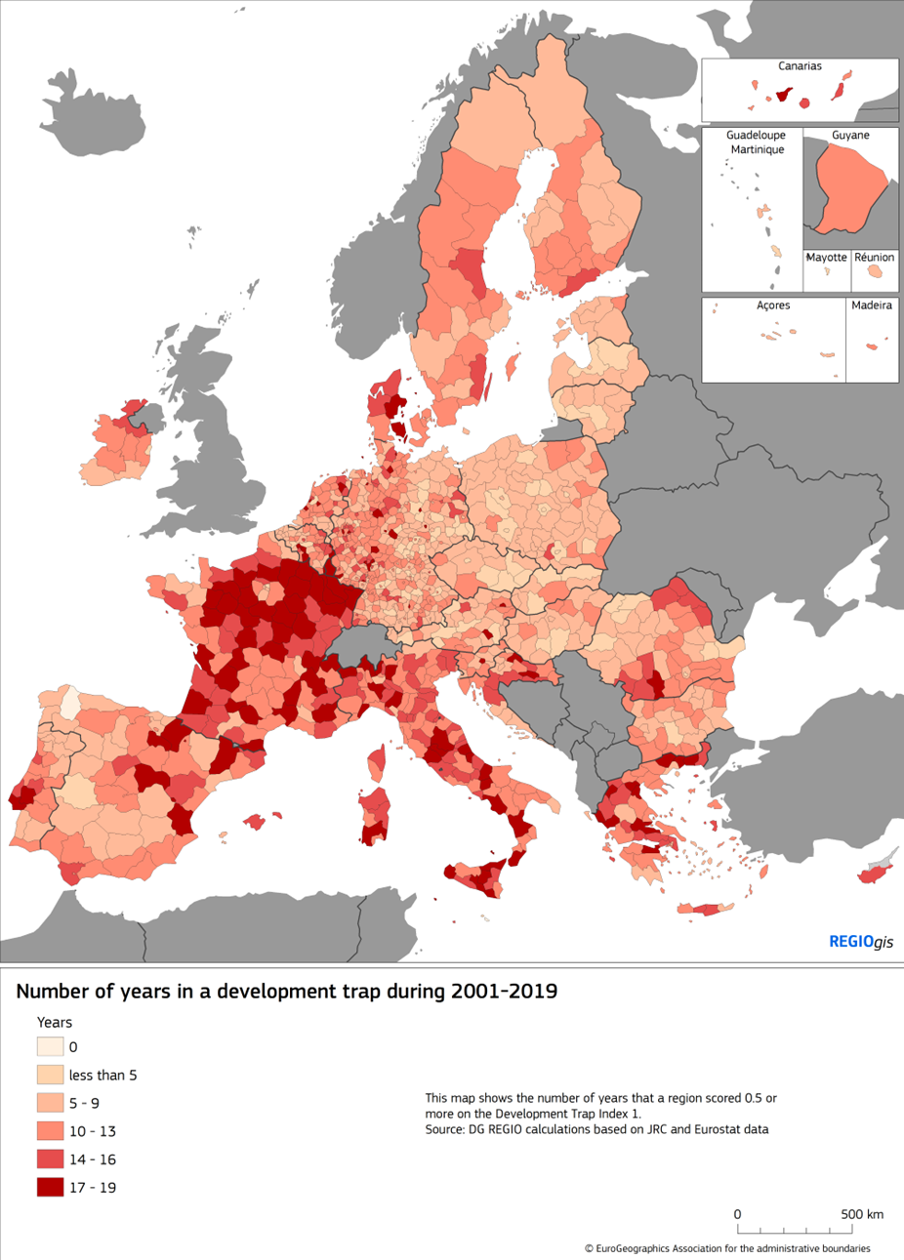
Length

Slide 14
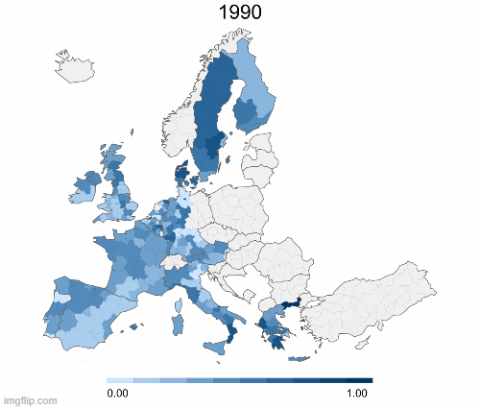
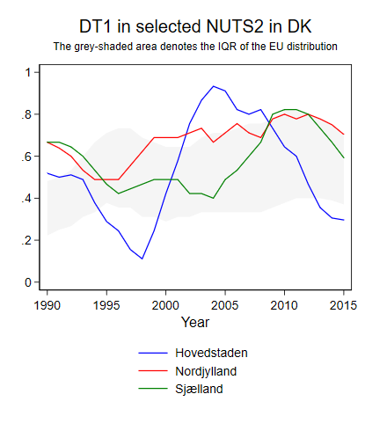
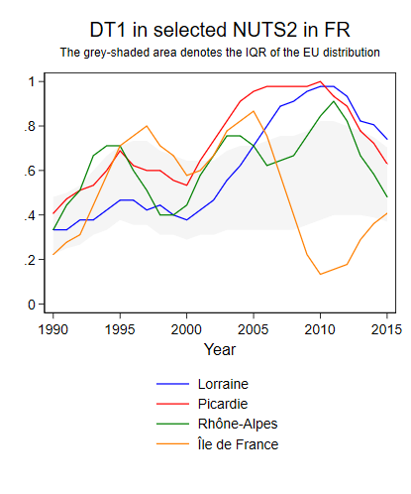
A dynamic phenomenon

Slide 15
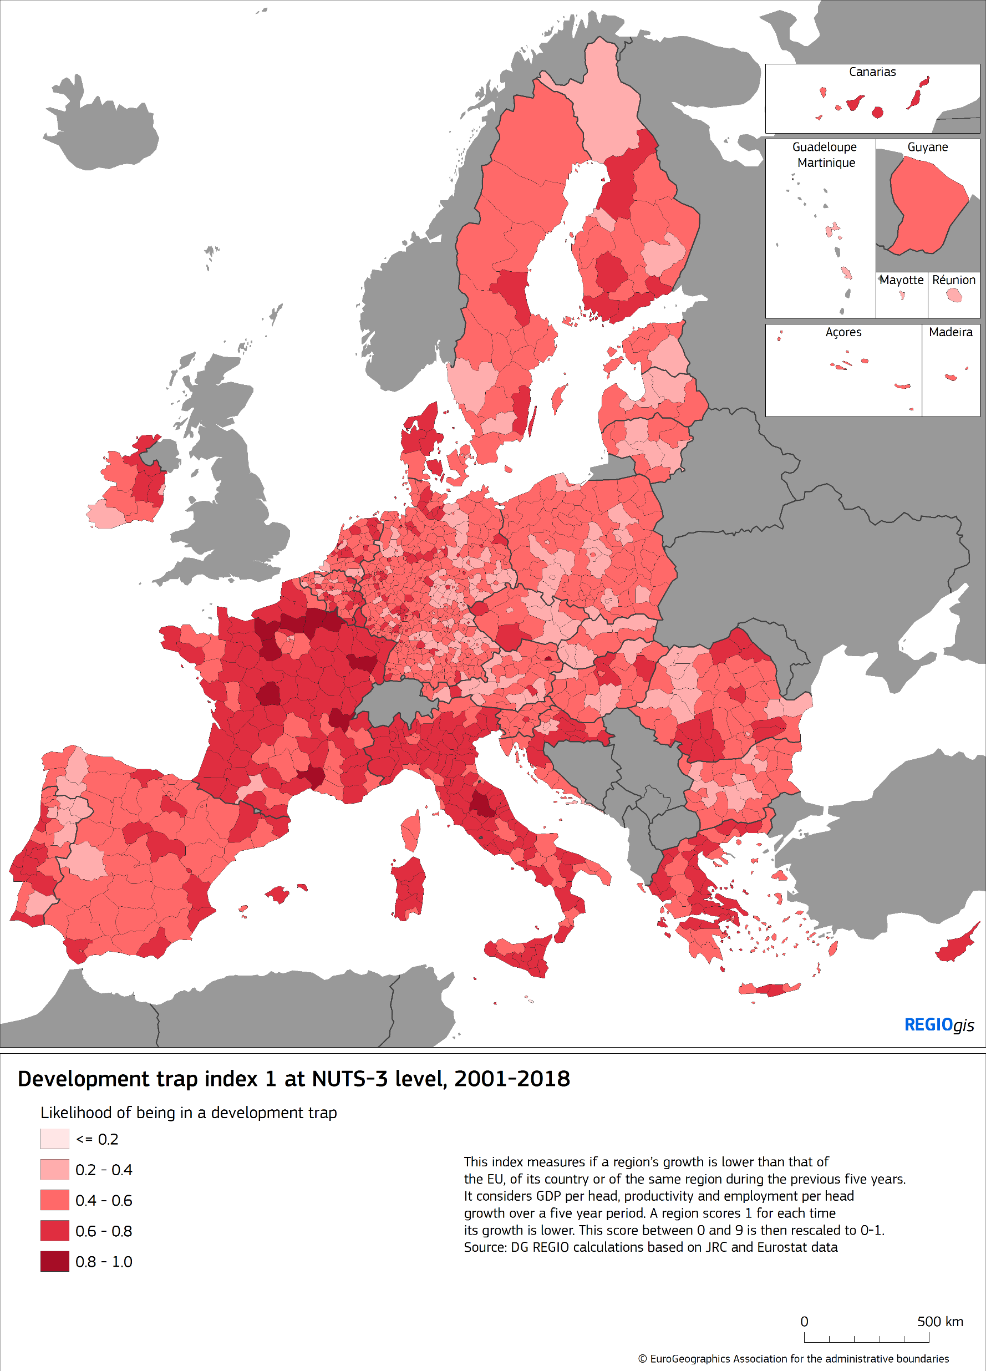
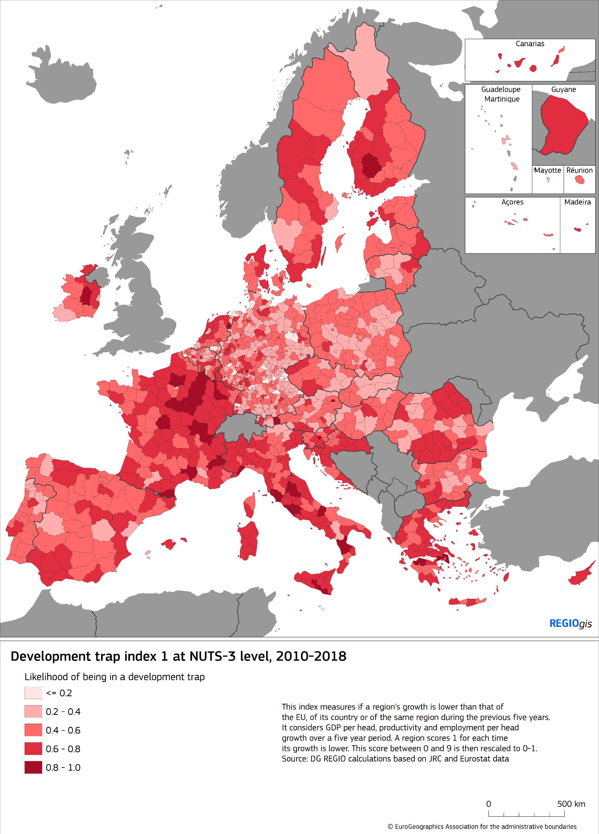
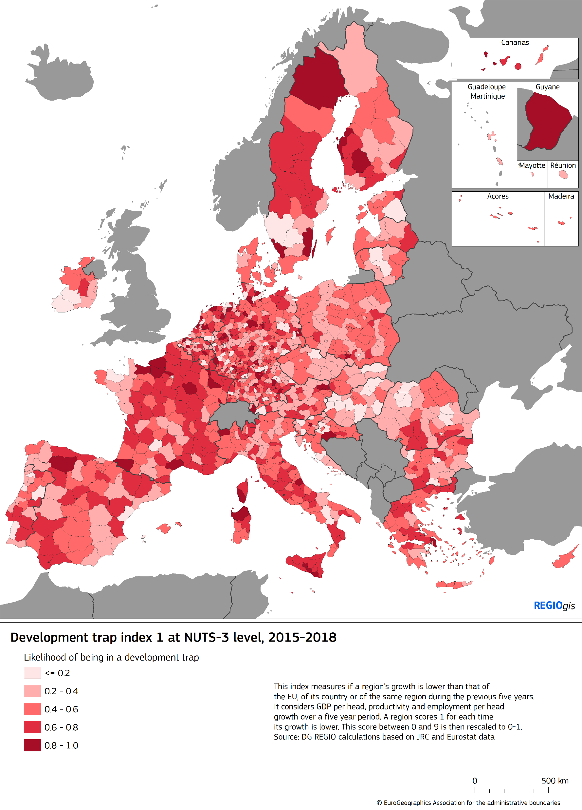
With changes in intensity

Slide 16
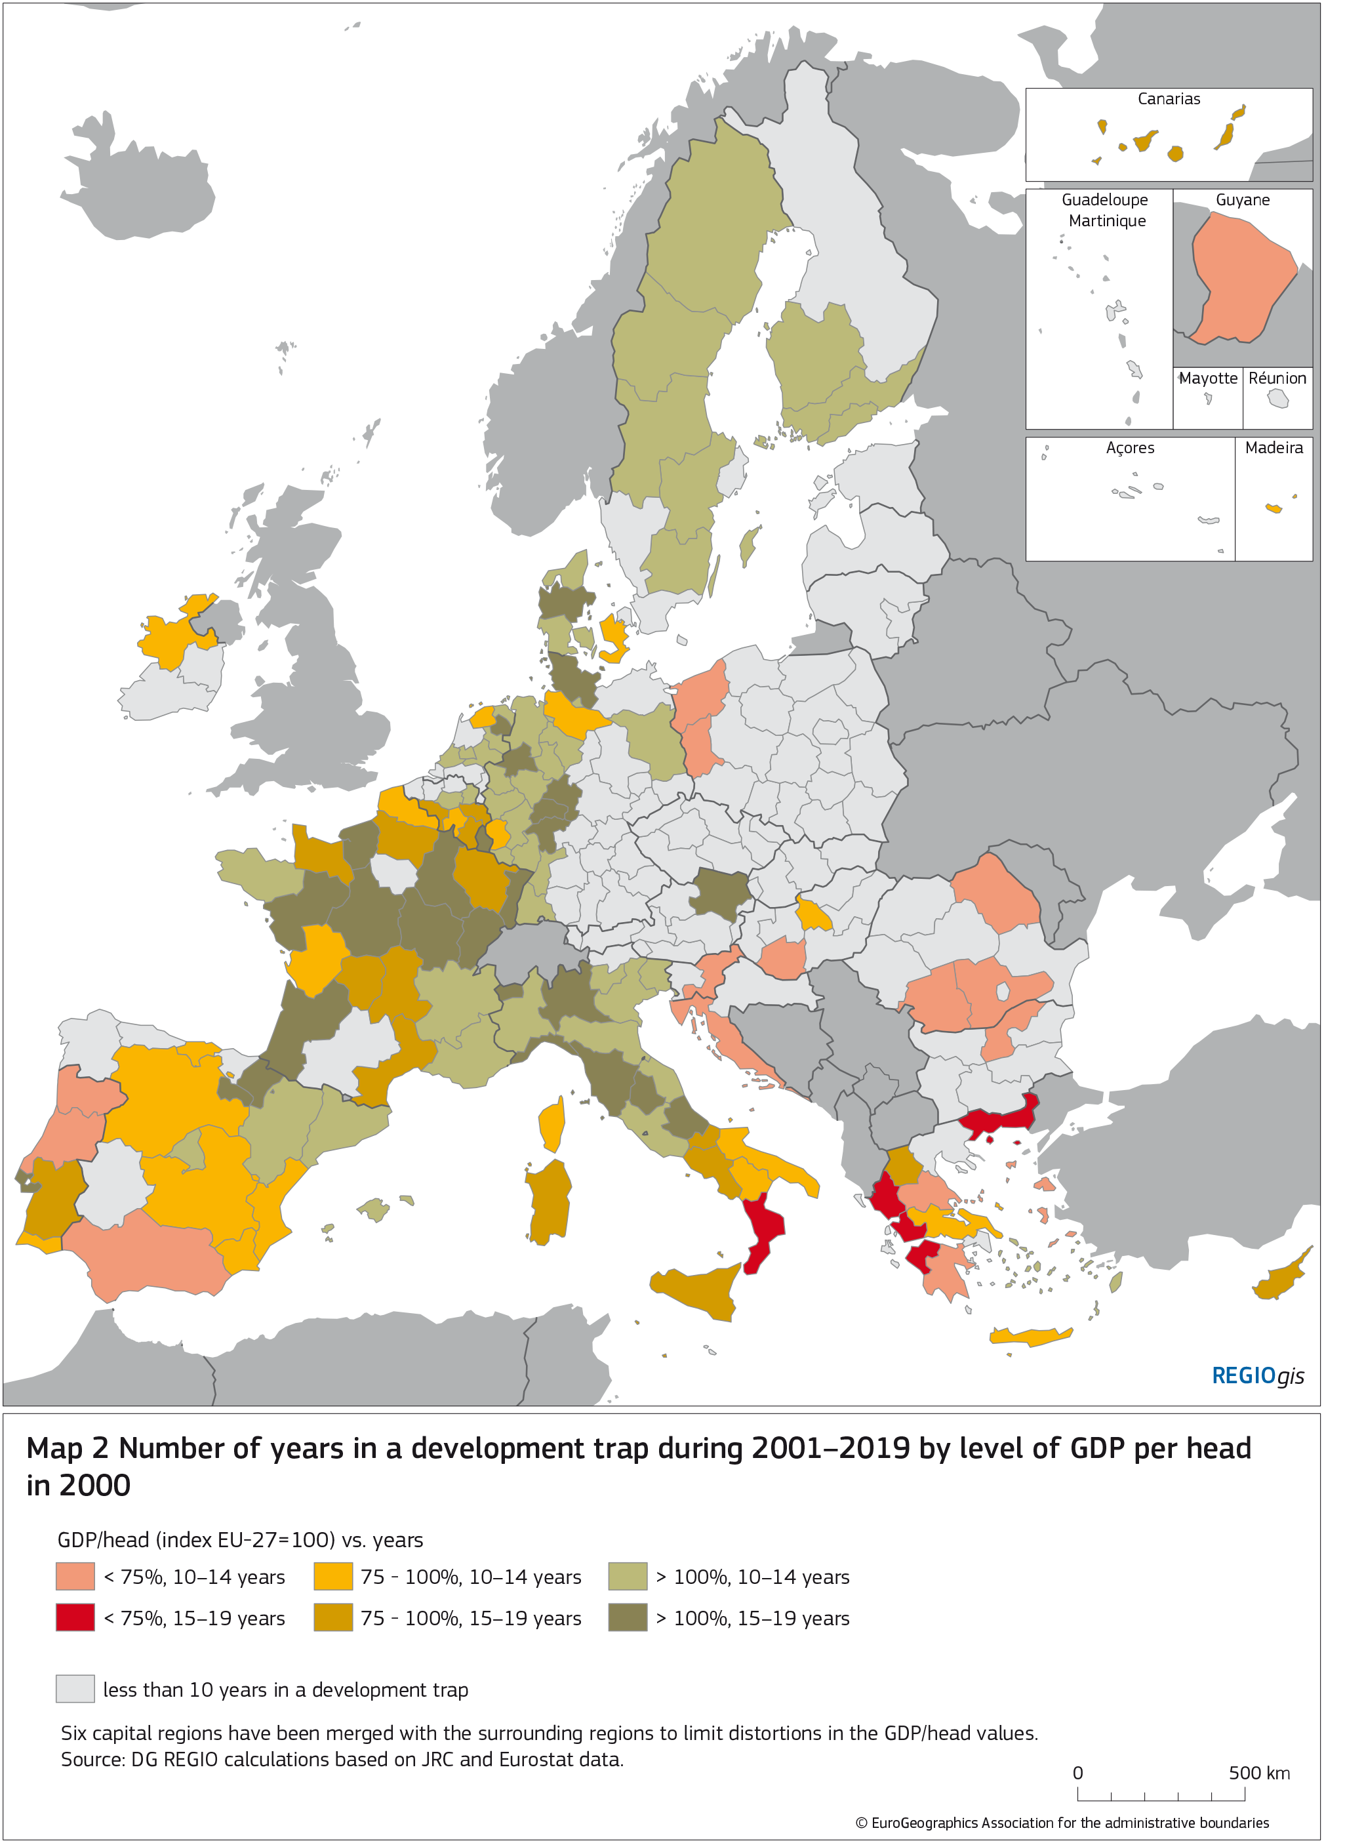
Happening at different levels of development

Slide 17
5.
Key policy takeaways

Slide 18
Key policy takeaways
Regional dynamics as a base for policy thinking (vs. the dominant static view)
Development traps can take place at all income levels
Need to address this important gap in policy
Using fundamentally a place-sensitive approach
Important source of discontent: People in trapped regions feel they don’t matter (or are left behind)

Slide 19
Obrigado
Contactos
@rodriguez_pose

