Slide 1
Portugal’s Growth and Development: A European Perspective
Peter Berkowitz
Director for Policy
Directorate-General for Regional and Urban Policy
European Commission
European Committee of the Regions, Brussels
27 March 2023

Slide 2
Structure of presentation
Growth, convergence and disparities in Europe and Portugal
Address some of the explanations for weakness in growth: development traps, competitiveness, demography
Cohesion policy impact and policy mix in Portugal
Conclusions
NB. Green and digital transitions very important, but will not be dealt with here.

Slide 3
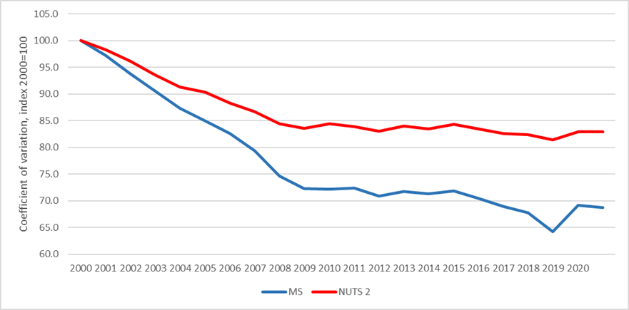
Evolution of regional disparities in the EU
Disparities between Member States and NUTS 2 regions rapidly decreased before 2008
Following the economic and financial crisis they stabilised for a few years and then resumed falling at a slower rate.
The increase in 2020 could be explained by the asymmetric impact of the COVID-19 crisis

Slide 4
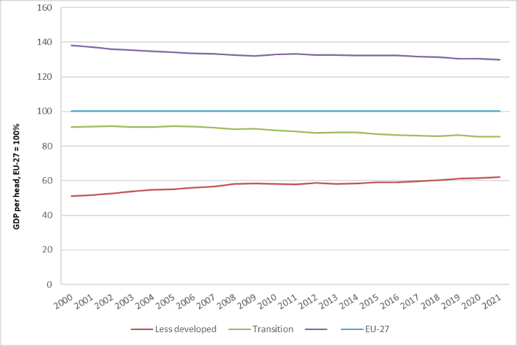
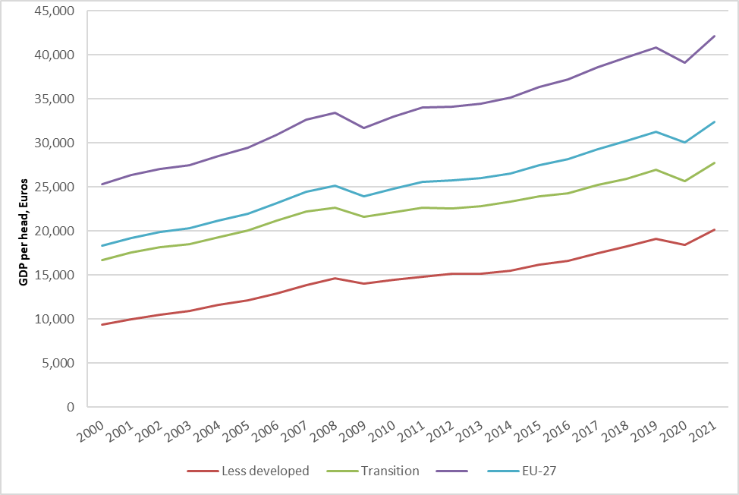
A process of upward relative convergence with growth in many regions
GDP per head (PPS), in less-, transition and more developed NUTS 2 regions, 2000-2020, relative to EU. Source: Eurostat; REGIO calculations. | GDP per head (PPS), in less-, transition and more developed NUTS 2 regions, 2000-2020, absolute terms. Source: Eurostat; REGIO calculations.

Slide 5
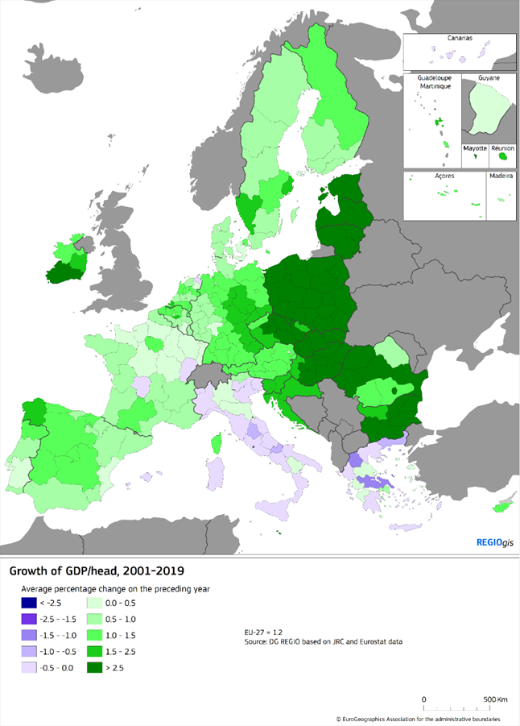
But a varied picture of GDP per head growth 2001-2019
Over the last two decades, real GDP per head increased in the EU but growth showed wide variations across the Union.
It was particularly high in the eastern European Member States and regions
GDP per head fell in a number of regions in Southern Europe, notably in Greece and Italy.
Growth was also relatively low in north of France, and parts of Spain and Portugal

Slide 6
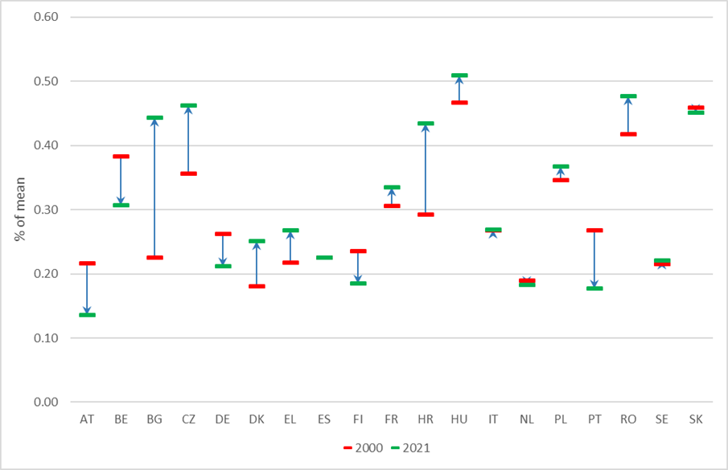
And varied dynamics within Member States
Regional disparities have decreased in Austria, Belgium, Germany, Finland and Portugal where growth in the less developed regions of the country was higher than in the more developed capital city regions.
In Bulgaria or Romania, increases in disparities have been driven by the very high growth rates in the most developed regions (the capital city region). Their other regions, however, still experienced higher growth than the EU average albeit at a slower pace than the capital region,.
In France or Greece, internal disparities increased because growth of GDP per head in the least developed and transition regions was particularly low – lower than in the most developed regions of the country but also lower than in the EU.
Coefficient of variation within Member States, GDP per head (PPS), NUTS 2 regions, 2000 and 2021. Source: EUROSTAT and DG REGIO calculations.

Slide 7
Annual real GDP per head growth 2011-2020 in Portugal
Portugal’s national growth rate is below the EU average
Lisbon has contracted from 121% of the EU average in 2006 to 96% in 2021.
The fastest growing regions (North and Centre) are growing more slowly than most regions in central and eastern Europe
Portugal is therefore likely to be overtaken by PL, HUN and even ROM in the coming years, if concerted policy action is not taken
Source: DG REGIO calculations based on JRC (ARDECO) and Eurostat data
X axis: GDP (PPS) per head (EU27 = 100), 2010
Y axis: Annual average growth of GDP per head in %, 2011-2020
Annual real GDP per head growth 2011-2020
Bubble size: population, 2020

Slide 8
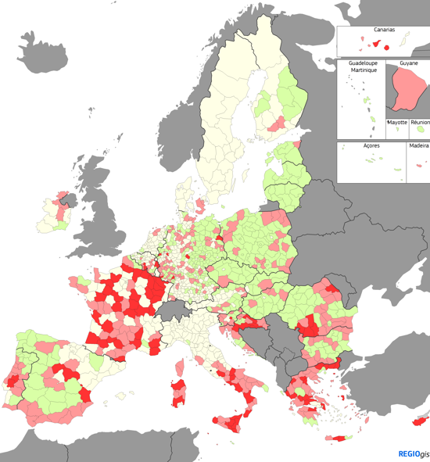
The role of development traps
A region is considered trapped if its growth has slowed down and is lower than EU and/or national growth 2001-2019.
The non-convergers (mainly Southern Europe)
The transition regions (mainly regions in more developed Member States)
The middle income trap – (fast growing Central European Countries)
Many exceptions (Puglia, Salonika, Crete, Southern Spain)

Slide 9
Competitiveness: RCI 2.0 – 2022
Basic sub-index
1. Institutions
2. Macroeconomic
Stability
3. Infrastructure
4. Health
5. Basic education
Efficiency sub-index
6. Higher education
7. Labor Market efficiency
8. Market size
Innovation sub-index
9. Technological readiness
10. Business sophistication
11. Innovation

Slide 10
RCI 2.0: Portugal
Main weaknesses:
Market size, internationalisation with exception of Lisbon
Higher Education and LLL (Lisbon underperforming as a capital)
Main differentiators between regions
Innovation
Infrastructure to a lesser extent
Generally same pattern but more accentuated for Azores and Madeira
PT on the whole performs better on RCI 2.0 than GDP per head

Slide 11
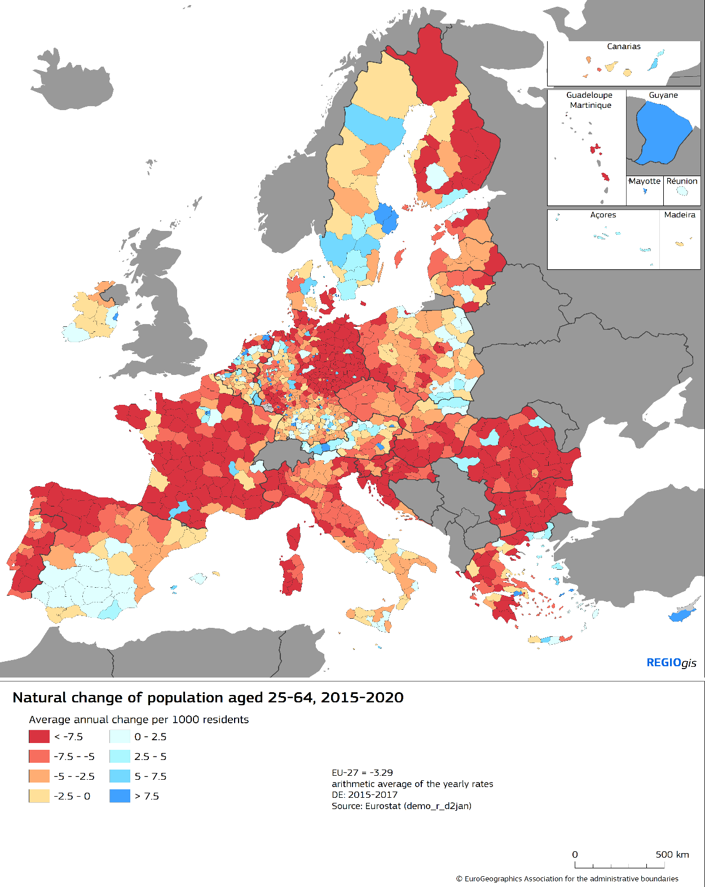
Demographic change
Demographic transformation of Europe is taking place caused by ageing, lower birth rates and migration flows
3.5 million decrease of EU working age population between 2015 and 2020
Further shrinking expected, with 35 million persons decrease by 2050
Mostly driven by natural changes
Some regions are more impacted than others, increasing regional disparities
Risk of talent development trap for regions affected by sharp workforce decline and low/stagnating share of tertiary educated or net out migration of their younger cohort
Portugal strongly affected in almost all regions

Slide 12
The importance of cohesion policy in Portugal
Impact measured relative to a baseline without cohesion funds 2014-2020
Assessment based on RHOMOLO model
Impact differs over time and across Portuguese regions / EU
Main drivers are levels and composition of expenditure, the features of the beneficiary economy (industrial fabric, its endowment in physical and human capital or its market access and transport costs)
Lisbon (PT17) relatively lower; Açores (PT20) relatively higher
Generally higher impact than in other Mediterranean countries and equivalent to central and eastern European countries

Slide 13
Policy mix in 2021-27
The policy mix of cohesion policy 2021-2027
PT aligned with other Mediterranean countries (EL, ES, IT)
Higher focus on sustainable mobility (but less than in other CF countries)
Compared to EU average and cohesion countries, higher investment in PO1 and PO4 (firms, innovation and social objectives).

Slide 14
Conclusions
Europe is following a model of overall upward convergence, but increasingly many regions are being left out of this process
There is no single spatial growth model in Europe, but many different situations
Portugal has been characterised by a process of internal convergence led by the economic contraction of the capital region, this is relatively untypical in Europe.
Even the fastest growing regions are growing more slowly than equivalent regions in many parts of central and eastern Europe, this is closely linked to declining productivity
The result is that Portugal has is falling behind faster growing Member States
Key factors are market size and internationalisation, higher education, lifelong learning creating a structural skills deficit and innovation and demographic change
Unique opportunity to make good use of the funds available from Cohesion Policy and the RRF.
Important to contribute to the discussion on the future of Cohesion Policy to build on the successes of recent years, particularly in less developed regions.

Slide 15
Thank you!
© European Union 2023
Notes:
Update/add/delete parts of the copy right notice where appropriate.
More information: https://myintracomm.ec.europa.eu/corp/intellectual-property/Documents/2019_Reuse-guidelines%28CC-BY%29.pdf

Slide 16
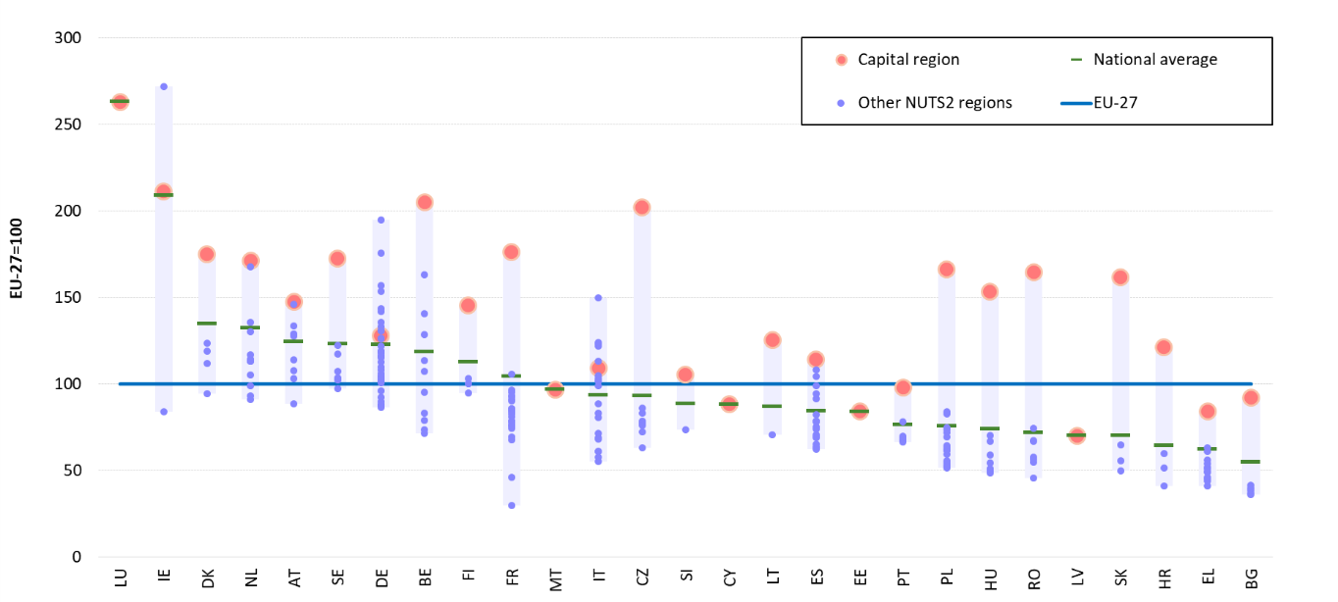
Wide variations in GDP per head both between and within Member States
GDP per capita (PPS) in Member States and in NUTS regions, 2021 (EU-27=100).

Slide 17
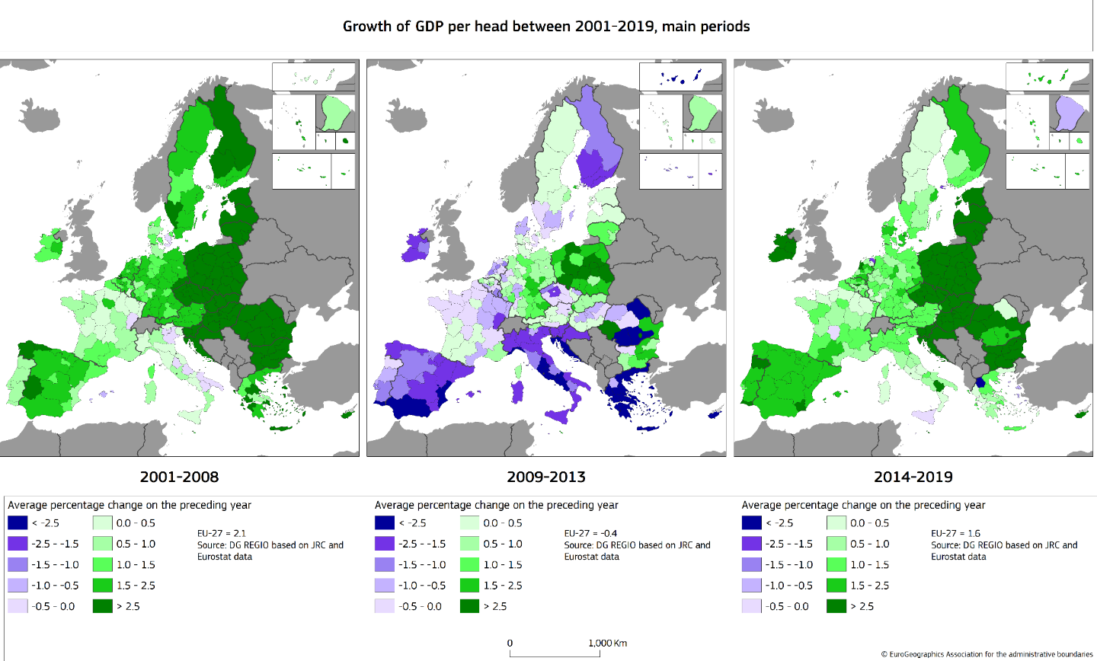

Slide 18
Region name | GDP per head (PPS) | Productivity (GVA (PPS) per person employed) | Real productivity growth | GDP per head growth | Population growth | Unemployment rate | At-risk-of-poverty or social exclusion | Population with high educational attainment | R&D expenditure
 | Index, EU27 = 100, 2021 | Index, EU27 = 100, 2021 | Average % change on the preceding year, 2011-2020 | Average % change on the preceding year, 2011-2020 | Average annual change per 1000 residents, 2011-2020 | % of active population, 2021 | % of population, 2021 | % of population aged 30-34, 2021 | % of GDP, 2020
European Union | 100 | 100,0 | 0,2 | 0,6 | 1,7 | 7,0 | 21,7 | 41,6 | 2,3
Portugal | 75 | 70,0 | 0,0 | 0,2 | -2,6 | 6,6 | 22,4 | 43,7 | 1,6
Norte | 65 | 61,5 | 0,4 | 1,0 | -3,5 | 6,6 | 25,8 | 42,5 | 1,8
Algarve | 76 | 67,7 | -0,4 | -0,1 | -3,0 | 8,2 | 25,4 | 29,6 | 0,5
Centro (PT) | 66 | 65,1 | 0,7 | 0,8 | -4,5 | 5,8 | 22,6 | 46,3 | 1,4
Área Metropolitana de Lisboa | 96 | 85,0 | -0,7 | -0,7 | 1,6 | 6,8 | 17,2 | 50,0 | 2,0
Alentejo | 71 | 68,4 | -0,6 | -0,1 | -8,1 | 6,6 | 20,3 | 38,2 | 0,9
Região Autónoma dos Açores | 66 | 62,4 | 0,1 | 0,0 | -1,9 | 7,2 | 27,5 | 22,6 | 0,3
Região Autónoma da Madeira | 70 | 67,2 | 0,3 | -0,6 | -5,4 | 7,9 | 29,2 | 34,7 | 0,5

Slide 19
RCI 2.0 – …but also large within country variation
Across EU Member States, the capital city region tends to be the most competitive in the country, with only a few exceptions (in Germany, Italy and the Netherlands).
More competitive countries tend to have a smaller gap between their capital city region and its other regions. They also have smaller differences between all their regions.
Notes:
In line with previous editions, the 2022 RCI shows a polycentric pattern, with a strong performance of regions hosting large urban areas in the EU, which benefit from agglomeration economies, better connectivity and higher levels of human capital

Slide 20
Productivity trends
Source: Eurostat, DG REGIO elaboration
Unit: real GVA in MM EUR (2015 prices) by employment in thousands of persons
The light red circle shows the capital city region. The blue circles show the remaining NUTS2 regions.
The green diamond shows the national average. The purple line shows the EU27 average.

Slide 21
Innovation is concentrated in more developed Member States and capital regions

