Slide 1

REGIONAL DEVELOPMENT CHALLENGES IN THE OECD AND PORTUGAL
Dorothée Allain-Dupré
Head of Division, Regional Development & Multi-Level Governance OECD Centre for Entrepreneurship, SMEs, Regions and Cities

Slide 2

Trends in regional inequalities in OECD countries (from forthcoming OECD Regional Outlook 2023)

Slide 3
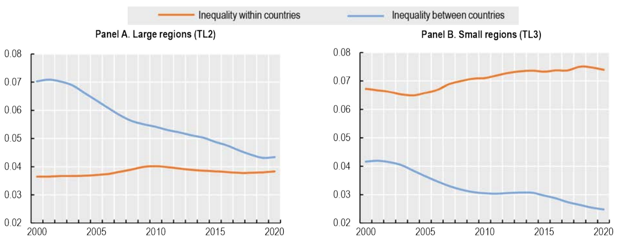
Inequalities between OECD countries have declined but not within-countries
Theil Index of PPP-adjusted GDP per capita, 2000-2020
Source: OECD Cities and Regions at a Glance (2022)
Overall income convergence between OECD countries
Income inequalities within countries (TL3) persist over time
"Dominant” regions pulling ahead

Slide 4























Different paths across countries – but 70% of people living in OECD countries experience interregional divergence
Decreasing/stable regional income inequalities
Increasing regional income inequalities
The Great Financial Crisis appears to have been a turning point.
A group of OECD countries, including countries like the UK, France, Sweden, Denmark and the US with per capita GDP above OECD levels, experienced a sustained rise in regional inequality since the mid-2000s
Others experienced a sustained decrease.
Above OECD mean GDP per capita
Converging to OECD mean GDP per capita
Diverging from OECD mean GDP per capita

Slide 5
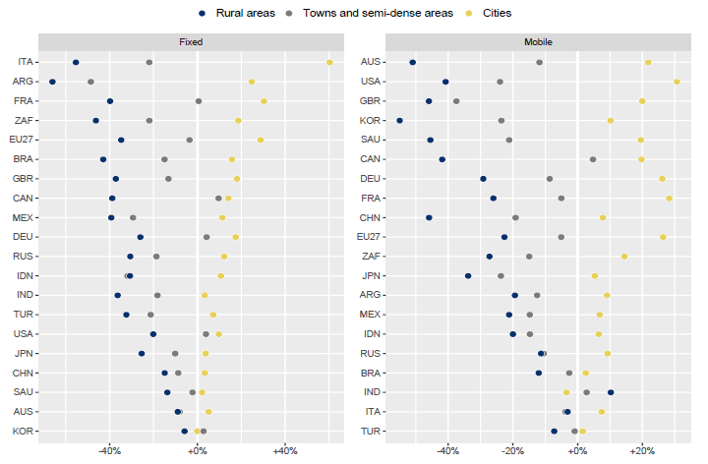
Territorial gaps in access to services translate into unequal outcomes
Service gaps – highlighted by the COVID pandemic
    Broadband
    Health
    Education
Unequal outcomes (health, education, gender gaps)
Economic, social, political costs of inaction
Download speeds over fixed networks in rural areas: 31 percentage points below the national average
Gaps in download speeds experienced by users by degree of urbanization
Source: (OECD, 2021) Implications of Remote Working Adoption on Place Based Policies

Slide 6

A zoom on Portugal

Slide 7
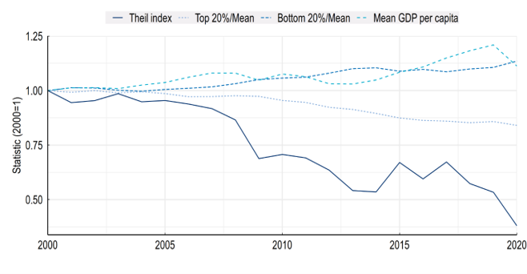
Portugal has experienced a sustained decrease in regional income inequality as measured by the Theil index
Source: OECD (forthcoming), 2023 Regional Outlook
7

Slide 8
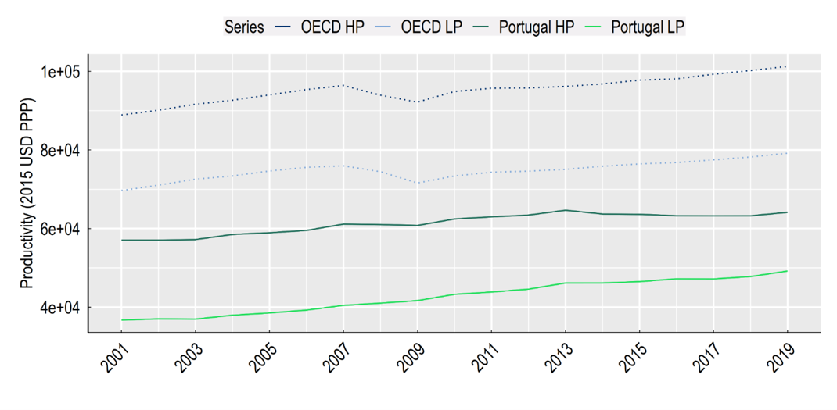
Challenge #1: Productivity challenge
HP: High-productivity regions / LP: Low-productivity
The low levels of labour productivity inequality can be explained by a “catching up” effect
Productivity in HP regions grew by 12.43% between 2001 and 2019: 21.53 % points less than LP regions
Portugal’s metropolitan areas are experiencing low productivity growth
Source: OECD (forthcoming), 2023 Regional Outlook

Slide 9
Challenge #2: Demographic challenge
Population dynamics in the largest FUA, other FUAs and outside FUAs in OECD countries
Portugal is one of the OECD countries facing the largest population decline (projected to be less than 9 million by 2050)
Non-urban areas, mostly in the inner parts of the country, are bearing the brunt of this decline
Source: OECD (forthcoming), 2023 Regional Outlook

Slide 10
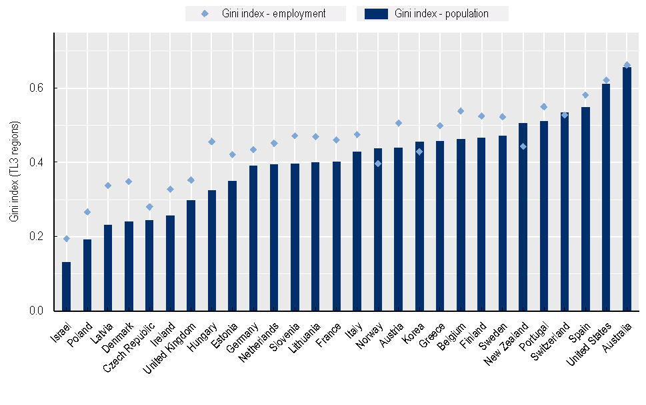
Challenge #3: Lack of employment opportunities in inland Portugal
The tertiary educated increasingly concentrate in cities
In Portugal, this may be mostly related to the concentration of job opportunities in cities
Employment tends to be highly concentrated in most OECD countries and Portugal is no exception in this regard
Source: OECD (forthcoming), 2023 Regional Outlook

Slide 11

Policy options

Slide 12

No “silver bullet” but five complementary policy levers

Slide 13
Example 1# Ensure equitable access to quality public services and infrastructure
In Japan - a country facing similar demographic challenges to those of Portugal - the Small Stations initiative creates basic service hubs to help sustain rural communities around small, multi-functional cores
In France, a network of over 1 000 Public Service Houses (Maisons de Service au Public) delivers public services in low density or isolated territories through one-stop-shops thus lowering fixed costs and staff needs for the different services

Slide 14
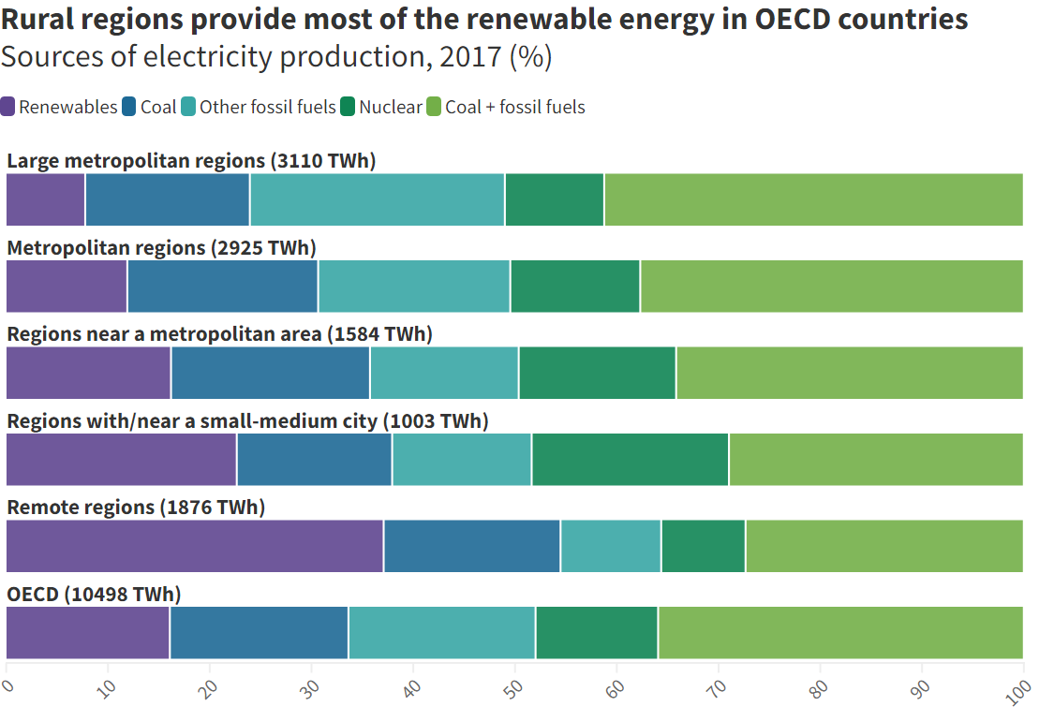
Example 2# Boost new development opportunities in inner regions
The green transition may bring new opportunities, especially for rural regions: rural regions produce 2/3 of renewable energy
Portugal : 29% of renewable energies in the total energy supply (compared to 12% in the OECD)
New global environment - Opportunities for reshoring or near-shoring
Source: OECD Regional Outlook (2021)

Slide 15

Example 3# Strengthen the regional level
Boost the productivity of metropolitan regions,
Multi-level Governance reforms: several ways forward
  Enhancing intermunicipal co-operation
  Strengthening regions/metropolitan areas
  Not a zero-sum game >> Focus on the strategic and monitoring role of the central government

Slide 16

Obrigada
Contactos
Dorothee.ALLAIN-DUPRE@oecd.org

